Slide 1
Welcome to HTCS Elementary
2021 – 2022 Open House

Slide 2
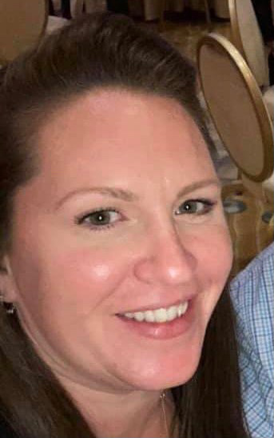
Meet Ms. Gillis
Hi, I’m Mrs. Gillis. I’m your students’ math and science teacher!
A little bit about myself:
I have been teaching students with special needs for 8 years
I have been with Heritage Trails for 6 years
I love things that smell good
I strive to keep my classroom clean at all times

Slide 3
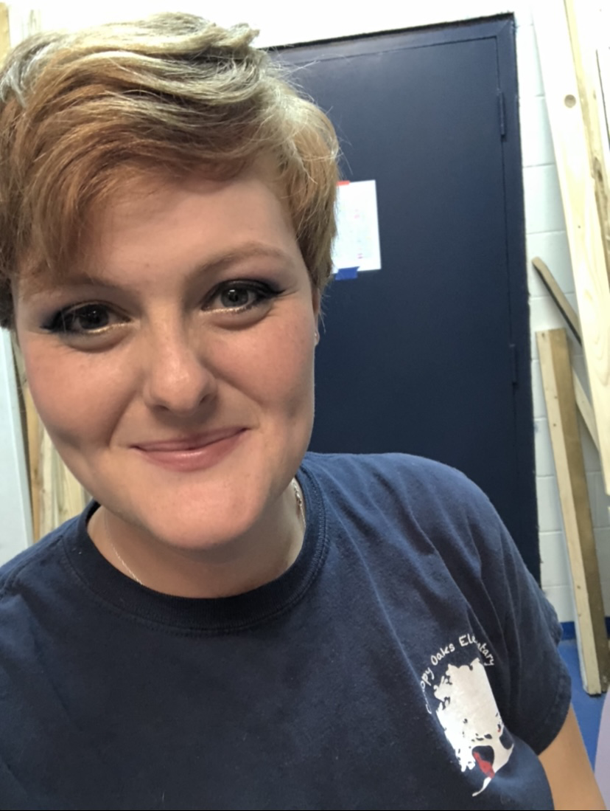
Meet Ms. Brown
Hi, I’m Ms. Brown, and I teach ELA and Social Studies
A little bit about myself:
This is my 4th year teaching at Heritage Trails
I have worked with Leon County Schools for 10 years!
I love reading books and discussing literature and media

Slide 4
Academics
What we’re learning:
Science: Solar System
Math: Strengthening foundational skills
Reading: Story Elements and Character Analysis
Writing: Writer’s Purpose and Cursive Skills

Slide 5
Homework Reminder
Ms. Gillis sends homework every Monday
You will find it attached to your child’s home note
Homework is due every Friday FOR A GRADE
Partial completion accepted for a partial grade
Homework is important as it targets skills your student needs to work on, and informs you about what we’re learning in class.
If you are having trouble completing homework with your student, please send Mrs. Gillis an email

Slide 6
Contact Us
Mrs. Gillis: gillisc@leonshools.neet
Ms. Brown: brownd6@leonschools.net

